Slide 1

Used Car Pricing Model
A Case Study of Toyota Used Car Sales

Slide 2
Table of Contents
01
03
02
04
Introduction
Model
Defining Problem and how to Solve
Machine Learning Models
Data
Conclusion
Data Knowledge
Outcomes
Future Work
05
What`s Next ?!

Slide 3
01
Introduction
Used Car prices depends on a lot of metrics , So pricing is not an easy task.

Slide 4
Problem and Challenges
A
B
C
Data
Problem
Challenges
Toyota Cars Prices for 18 Different Model
From 1998 to 2020
Predict used car prices
Using ML Model
Cars that are more than £1500 above the estimated price will not sell

Slide 5
How To Solve
1
2
3
Data Exploration
ML Model
Overcome Challenges
Explore and analyze Toyota Data set to know the relationship between prices and other data like model, year, etc.
Develop and Deploy ML Model to predict used car prices
Measuring Model prediction Accuracy depending on :Cars more than £1500 above the estimated price will not sell

Slide 6
02
Data
Data Exploration

Slide 7
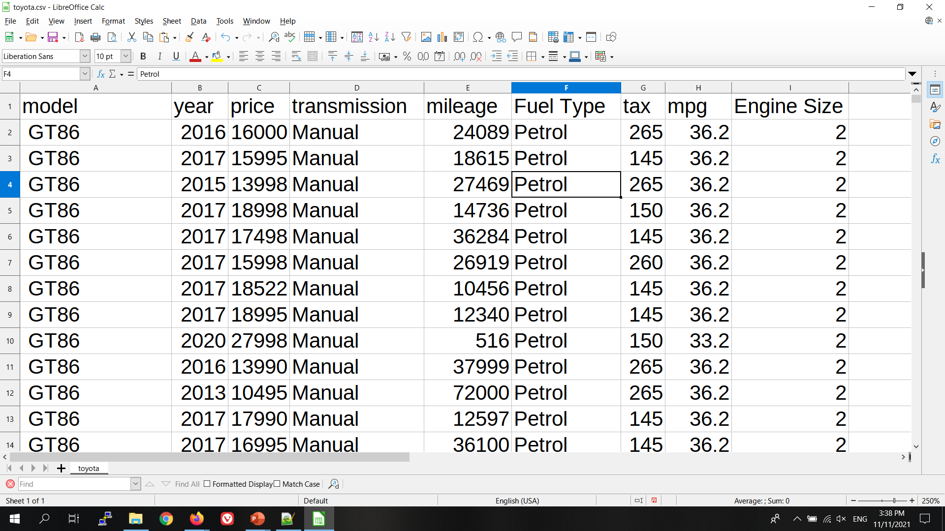
Data Description
Model Toyota model.
Year: registration year.
Transmission : Type of gear box.
Mileage : distance used.
Fuel Type: engine fuel Type.
Tax : road tax.
MPG : miles per galloon.
Engine Size: size in liters.
Features
Label
Price : Price in Euros.

Slide 8
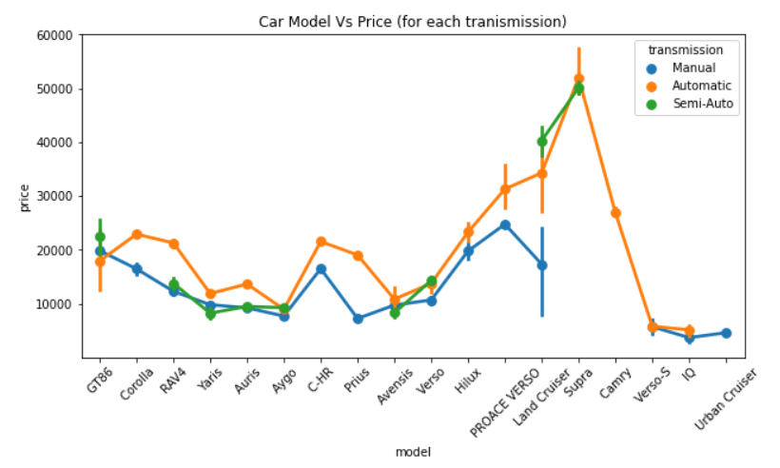
Price Over Car Model
This Plot Shows AVG Price For each model along With it`s confidence interval

Slide 9
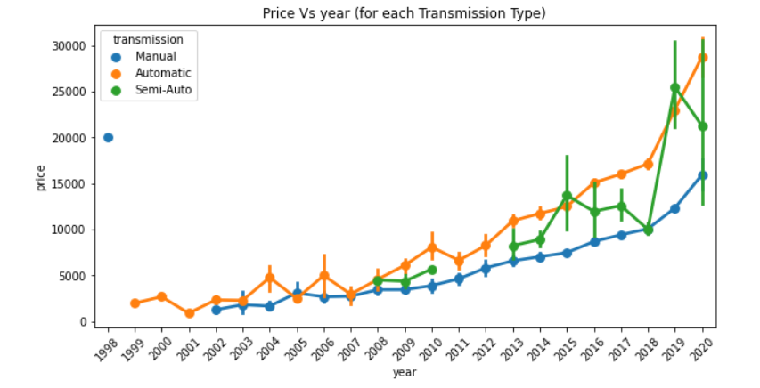
Price over Year
The newer the model the higher the price
Automatic Cars have The highest price then Semi-Auto Cars.
Manual Cars had a steady pricing curve over years

Slide 10
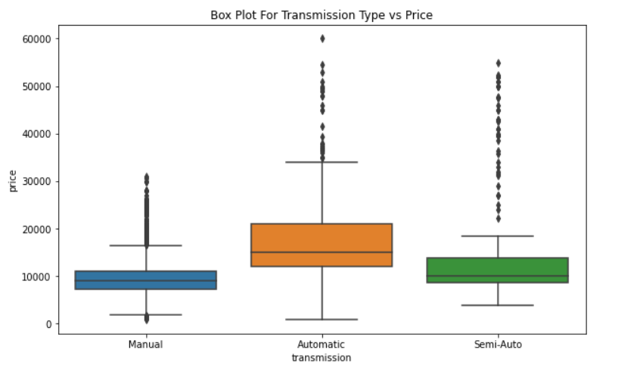
Price Vs
Transmission Type
Automatic Cars have The highest prices
Semi-Auto Cars have moderate Prices
Manual Cars have the lowest prices

Slide 11
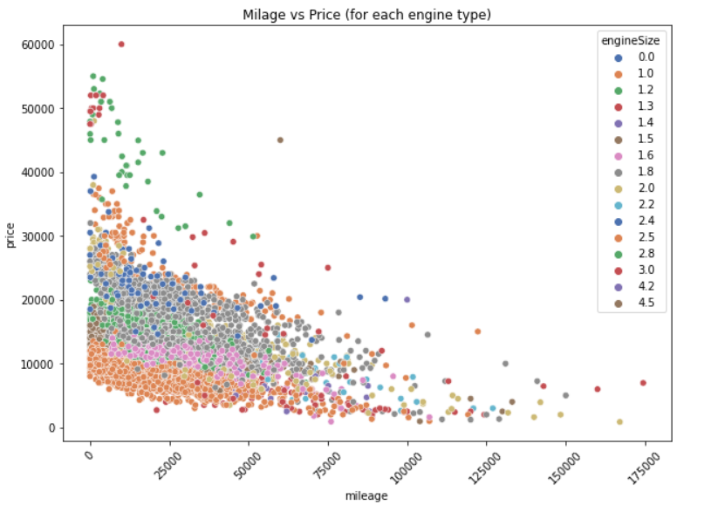
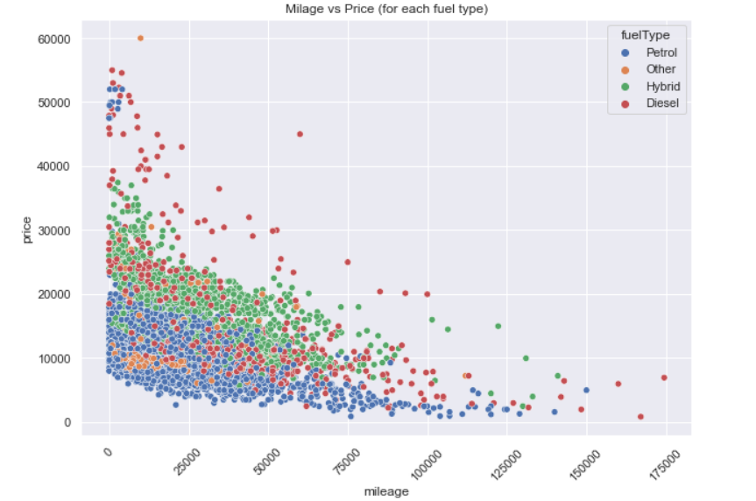
Price over Milage
There is a strong inverse relationship between prices and mileage

Slide 12
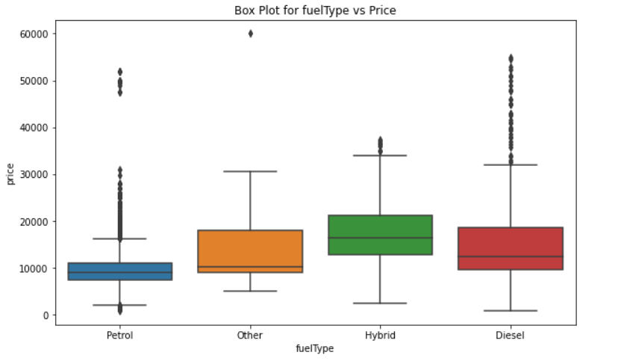
Price Vs Fuel Type
This shows the Boxplot of prices for different fuel types.

Slide 13
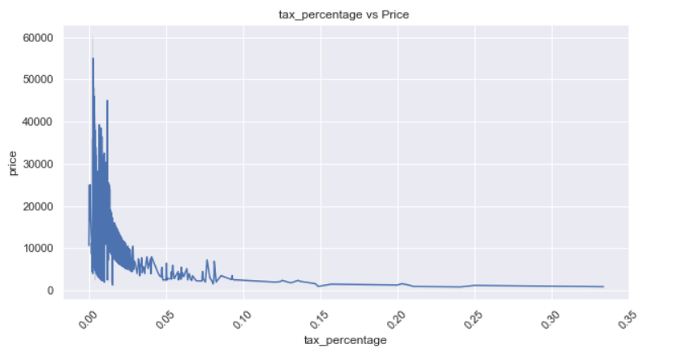
Price Over Tax Percentage
There`s an inverse relationship bettwen prices and tax percentage.

Slide 14
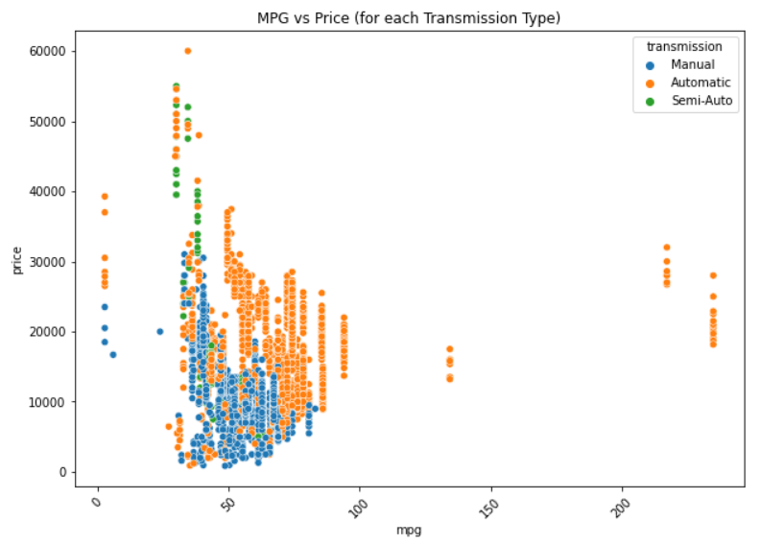
Price Over MPG
There`s a week inverse relationship bettwen prices and mpg.

Slide 15
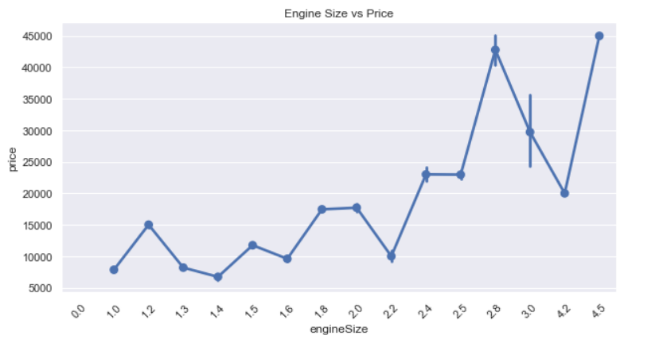
Price Over Engine Size
This Shows the AVG Prices for each engine size.

Slide 16
03
ML Model
Our Machine Learning Models

Slide 17
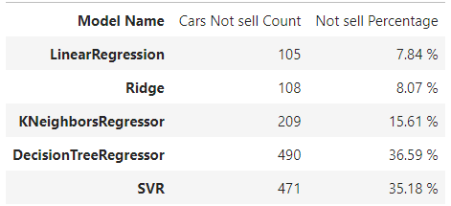
To get The best results , We have tried Different techniques and test them.
Best of them Was LinearRegression Which Had a 7.48% of Cars £1500 + The Fair Price .

Slide 18
04
Conclusion
Our Investigation Summry

Slide 19
Conclusion
EDA help us to understand the features, their distributions and their relationships
Data Cleaning was necessary in some columns such as transmission
We Tried Five Deferent Regression Models.
a simple linear regression was the best , it had 7.84% estimates over the market price + 1500
Initial results of the Linear Regression model are satisfactory

Slide 20
05
Futuer Work
What`s Next ?!

Slide 21
What`s next ?!
Hyperparameter tuning needs to be done through Grid Search for example.
Try Scaling methods to see if they can improve the data distribution.
Try other encoding methods to see if they can improve the model performance and decrease this large number of columns
large numbers of columns needs to be decreased through PCA .
Other models needs to be tested such as XGBoost which would improve the results of the Decision Tree through ensemble learning where we make use of multiple weak learners.
These actions should improve the pricing model and lower the number of cars with over price of 1500+

Slide 22

Thanks!
Do you have any questions?
Eng.mhemaly@gamil.com
+201555584904

